Slide 1
When you feel new…
What can help us to make a good start to a new stage of life?

Slide 2
Feeling new?
Coming to a new school and making a fresh start can be exciting and fun
Then again it can be a bit worrying, and feel like hard work some days
What helps?
Try asking yourself: can ancient wisdom help?
On the next slide, nine things that may be difficult or good about new starts.
Which are good, and which are hard for you?

Slide 3
What is hard about moving schools? What is good about moving schools?
Finding my way around
Learning to fit into the new school
Hoping to do my best
Feeling tired
Making new friends
Being more like a grown up
Trusting that things will work out well
Thinking about my future
Not feeling lonely
On the next slide, Oliver, aged 12, expresses his feeling about starting at a new school in picture. Guess what he drew.

Slide 4
Oliver made his artwork to express a feeling we all have sometimes. Do you feel that the obstacles of life get in the way of your joy and achievement?

Slide 5
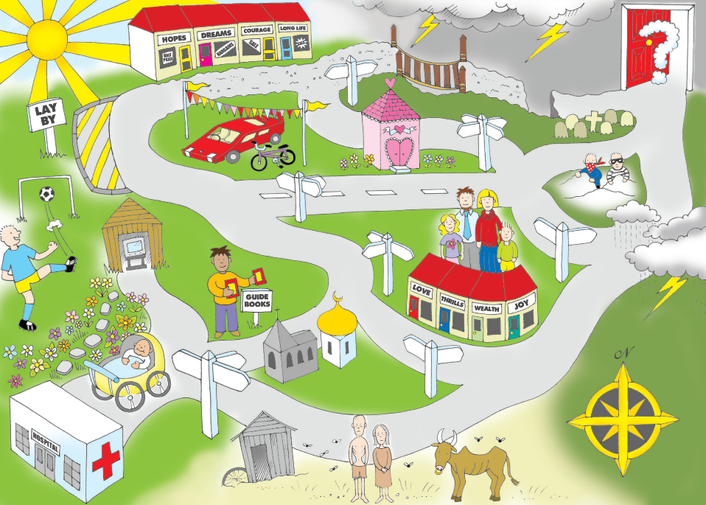
This guy is giving away guidebooks to life’s journey.
Life is like a journey. Notice some good things and some bad, in this picture of the journey of life. And notice that people are uncertain what happens at the end. What helps us find our way on the journey of life?

Slide 6
Good News For Everyone! is a charity that gives away Bibles…
Why? Because we think that the Bible is like a guidebook to life, something everyone needs.
As you make a start in your new school, you can receive a free copy of the Christian scriptures, the New Testament and Psalms.
It is full of guidance for life.
For example, the Bible has something to say about the opportunities and worries of making a fresh start. Look at the examples on the next slide. Which do you think are the wisest?

Slide 7
Finding my way around | “Give your burdens to the Lord, and he will take care of you.” Psalm 55:22
Making new friends | “The seeds of good deeds become a tree of life; a wise person wins friends.” Proverbs 11:30
Trusting things will work out well | “Those who know your name trust in you, for you, O Lord, do not abandon those who search for you.” Psalm 9:10
Learning to fit into the new school | “If your gift is to encourage others, be encouraging. If it is giving, give generously.” Romans 12:8
Hoping to do my best | “Use your hands for good hard work, and then give generously to others in need.” Ephesians 4:28
Being more like a grown up | “Live in harmony with each other. Don’t be too proud to enjoy the company of ordinary people. And don’t think you know it all!” Romans 12:15-16
Not feeling lonely | “God has said, “I will never fail you. I will never abandon you.” Hebrews 13:5
Feeling tired | “Be on guard. Stand firm in the faith. Be courageous. Be strong.” 1 Corinthians 16:13
Thinking about my future | “For I know the plans I have for you,” says the Lord. “They are plans for good and not for disaster, to give you a future and a hope.” Jeremiah 29:11

Slide 8
Catherine, 10, wrote this introduction to the ‘Guidebook of Life’ Write your own version, using the wisdom you have studied.
Will your guide to life have something to say about…
Bravery?
Friendliness?
Forgiving?
Kindness?
Dealing with problems?
Faith?
Prayer?
What matters most?

Slide 9
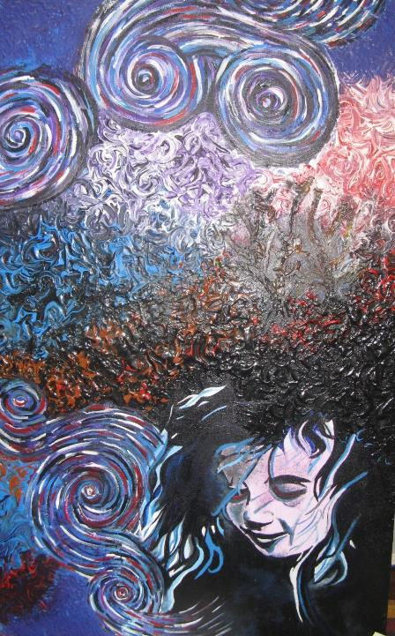
Sam, 13.
“My painting shows a young teenager looking down, and rather worried and anxious. The swirl in front of her face is for all the questions she is asking. But if she looked up, she would see all the light and love she needs. Sometimes if we look up then God’s Spirit is right there, ready to help us face our problems. It is like the saying of Jesus about praying: ‘Ask and it will be given to you.’”
What do you think?

Slide 10
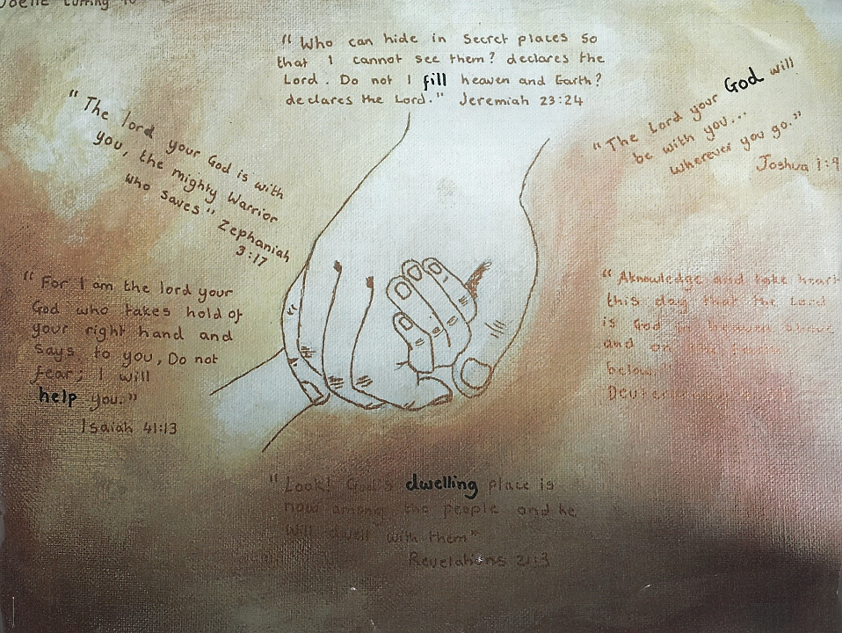
Joelle is 14. She writes:
God can be up-close and personal
“I believe that God can be up-close and personal as he wants a relationship with us. My use of the child sized hand holding an adult sized hand symbolizes many things: how God is our Father and we are his children, how he is so much bigger and more than we can comprehend and lastly how God is near.
I also used a gold background to show that although God is up-close and personal he is holy at the same time. I have then used Bible quotes to show how I believe God is near if we are willing to reach out.”

Slide 11
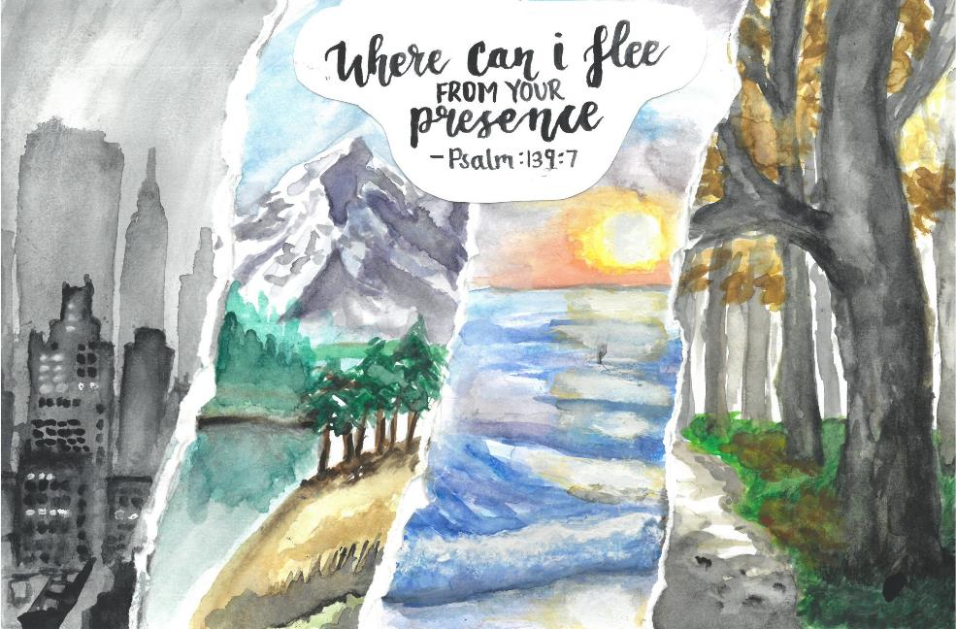
Nicole (14)
“I painted a quote from the Bible saying “Where can I flee from your presence?” to show that God is everywhere in our lives and in the world. I used different landscapes for example a busy city and a peaceful beach. This shows very different places all across the world but the thing that brings them together is that God is in all of them. All the edges are ripped but the Bible quote in the centre brings them together.
Each setting can represent different parts of life. For example the city can represent fast paced, busy times, the mountains can show a challenge needed to overcome, the beach can represent peace and calm and the woods can represent the idea of being lost or trapped. All these different times in life show that during all of this time God is always there. The Bible quote is a reminder that God is everywhere. In everything in the world but also he is in every part of our lives.”

Slide 12
New starts: not always easy
If you have been anxious or worried as you start at the new school, then there are many people to help you – teachers, family, friends.
Some of your best friends for the future, you have only just met!
Ancient wisdom might give you things to think about too. Some people find prayer helps them a lot.
Take your copy of the Bible, and remember that Christians think it is a guidebook to life.
We hope you enjoy reading it!

Slide 13
Additional activity (this slide is for leaders, not pupils)
The ‘Spoken Word’ narration describes the Bible in 45 vivid references in just over 2 minutes.
Some may say it is too difficult for 11 year olds, but they will learn much from it.
Play the clip (YouTube link on the next slide)
Show the text to pupils (on the following slide)
In an assembly, refer to a couple of examples of what it says about the Bible.
In a classroom RE/RME lesson, ask pupils to say which ones they understand and which ones they don’t.
Ask: Does it help them to see the significance and value of the Bible? How and why?

Slide 14
The Spoken Word – YouTube Link

Slide 15
It is written
It is hated
It is against the law
It is fuel for the flames
It is cherished
It is what the law is built upon
It is why some were burned at the stake
It is the whip of the master and the strength the slave
It is the railroad to freedom, a guiding star
It is hope beating in the hearts of the poor
It is poetry, memorised and sung
It is propaganda repeated until ears become numb
It is ancient. It is wisdom, tattooed on our skin
It is justice that rulers swear to uphold
It is knowledge carved into the walls of institutions
It is genius. It is foolish
It is war starting. It is peace making.
It is ‘In the beginning’. It is Revelation.
It is middle ages. It is timeless.
It is future for those with faith
It is history for the atheist
It is present. It is inescapable
It is a force in everyone‘s story
It is a story. It is a book.
It is ink on pages
It is tangible. It is physical.
Hold it, read, taste it.
See: it is fleshly. It is human.
It is other worldly.
It is strange. It is mystery
It is mysteriously powerful
It is inside outing. It is upside downing
it has turned the earth on its head
It has shaped our world
And yet is a world often left unexplored
It is a world worth exploring
It is worth your time
What you discover just might be divine.

Slide 16
Additional activity
The ‘Spoken Word’ describes the Bible in 45 vivid references in just over 2 minutes.
Can you say which sentences in the performance you understand?
Which sentences did you not understand?
Does this performance tell you more about the significance and value of the Bible? How and why?
Select your favourite 10 sentences, and perform them yourself.

Slide 17
When you feel new…
What can help us to start a new stage of life well?

