Slide 1
Remembrance
Bravery and courageous sacrifice, inspired by the words of the Bible

Slide 2

Remembrance
The story of a man inspired by the Bible from the First World War
Notes:
Tell the story of Dr Noel Chavasse, linking it to the words of Saint Paul. The best way to do this is to learn the story and retell it in your own words, practicing till you are very good at it. An alternative is to do an inspiring reading of the story.

Slide 3
The Bible says …
“
Whoever shares with others should do it generously. Whoever has authority should work hard. Whoever shows kindness to others should do it cheerfully. Love must be completely sincere. Hate what is evil, hold on to what is good. Love one another warmly, as Christian brothers, and be eager to show respect to one another. Work hard. Do not be lazy. Serve the Lord with a heart full of devotion. Let your hope keep you joyful. Be patient in all your troubles. Pray at all times.
14 pieces of advice from Saint Paul, Romans 12:8–11, GNT
”
Good News Translation® (Today’s English Version, Second Edition) Copyright © 1992 American Bible Society. All rights reserved.
© RE Today Services, 2018
© RE Today Services, 2018
Notes:
This scripture passage is a good one to highlight – it contains 14 pieces of advice about Christian behaviour which Noel Chavasse seems to have followed faithfully. Tell the pupils that this is a way the Bible can guide a person who is determined to follow its teaching.

Slide 4

Was Dr Noel Chavasse an inspirational person?
Was he a good follower of Jesus?
Connects to RE units on conflict and peace, Bible teaching, inspirational people, history and RE, religious commitment, etc.
Suitable for pupils aged 11-12.
© RE Today Services, 2018
Notes:
These questions are typical of those asked by RE or RME lessons

Slide 5
Stretcher bearing in the trenches was one of the most deadly and difficult roles in WW1. Noel did this voluntarily, saving many lives under fire, when he had finished his daily work as a field hospital doctor.
Imagine how courageous and unselfish people needed to be to do this as volunteers.

Slide 6
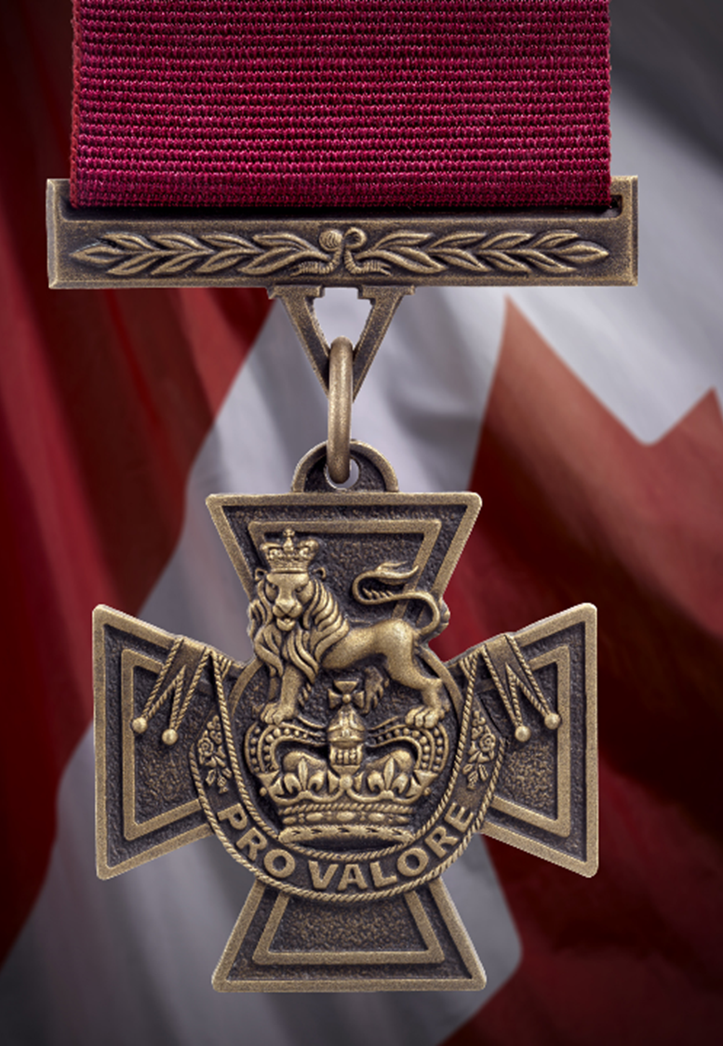
https://www.britishlegion.org.uk/stories/the-only-vc-and-bar-of-the-first-world-war
Noel’s letters home show that he was a committed young Christian, keen to put his faith into practice in everything, and eager to follow the teaching and example of Jesus. This picture is of his first VC, given to service people ‘for valour’.

Slide 7
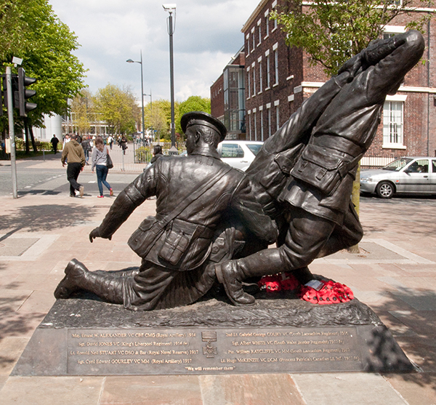
Noel’s memorial in his home city of Liverpool is a focus for Remembrance every November 11th. He is seen here working with another soldier to save a wounded man from ‘no-man’s-land’. The memorial quotes Jesus, from the New Testament.
“Greater love has no one than this, that a man lays down his life for his friends.”
Notes:
Noel’s memorial in his home city of Liverpool is a focus for Remembrance every November 11th. He is seen here working with another soldier to save t=a wounded man from ‘no-man’s-land’. The memorial quotes Jesus.

Slide 8
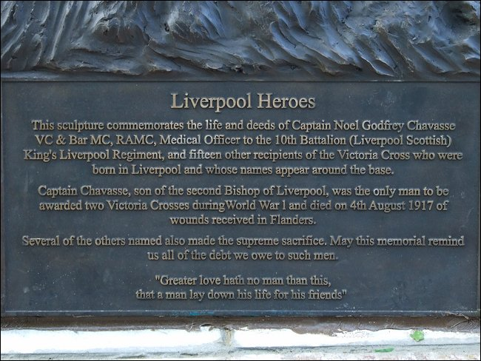

Slide 9
Which teachings of the Bible do you think Noel Chavasse followed best? Choose any three.
To discuss and vote
“Whoever shares with others should do it generously.”
“Whoever has authority should work hard.”
“Whoever shows kindness to others should do it cheerfully.”
“Love one another warmly, as Christian brothers, and be eager to show respect to one another.”
“Serve the Lord with a heart full of devotion.”
“Let your hope keep you joyful.”
“Be patient in all your troubles.”
“Pray at all times.”
© RE Today Services, 2018
Notes:
Ask pupils to discuss or vote upon these examples of Bible teaching: which did Noel most clearly put into practice? In what ways did the bible guide his life? Was he a good follower of Jesus?

Slide 10
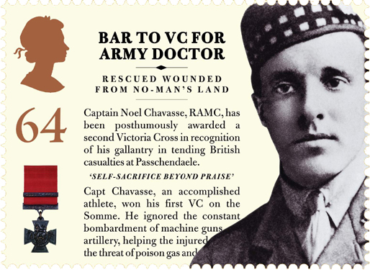
Notes:
The second VC =-known as a ‘bar’ – was presented after Noel’s death. He is one of only three people to ever be awarded a second VC, and the only one in WW1.

Slide 11
A memorial for Noel Chavasse
Notes:
Asking pupils to devise a memorial for Noel’s church is a good way to get them to think about their own responses to his story and the palce of the words of the bible within the story. Showing some examples is not meant to have them copy others’ ideas, but just to open up some possibilities.

Slide 12
A memorial for Noel Chavasse

Slide 14

Design a memorial for Noel Chavasse

Slide 15
The Bible says …
“
Whoever shares with others should do it generously. Whoever has authority should work hard. Whoever shows kindness to others should do it cheerfully. Love must be completely sincere. Hate what is evil, hold on to what is good. Love one another warmly, as Christian brothers, and be eager to show respect to one another. Work hard. Do not be lazy. Serve the Lord with a heart full of devotion. Let your hope keep you joyful. Be patient in all your troubles. Pray at all times.
14 pieces of advice from Saint Paul, Romans 12:8–11, GNT
”
Good News Translation® (Today’s English Version, Second Edition) Copyright © 1992 American Bible Society. All rights reserved.
© RE Today Services, 2018

Slide 16
Remembrance
Lesson and assembly ideas for GOOD NEWS For Everyone!
© Lat Blaylock, 2019-21

