Slide 1

The real meaning of Christmas?
What do you think?
The book that tells us everything we know about Christmas for Christians: the Bible

Slide 2
The Real Meaning of Christmas?
Today we will be learning about several different ideas to do with the meaning of Christmas.
The question for you to think about is: what does the festival really mean?
Some people think the real meaning of Christmas can get a bit lost underneath all the presents, money, spending and (to be honest) selfishness.
What do you think?

Slide 3
The Real Meaning of Christmas?
We asked some young artists what they thought was the real meaning of Christmas.
They each made a work of art to answer the question.
Whose answer do you like best? We linked each artwork up with a quotation from the Bible.
Discuss your reaction to the four artworks with a partner. Rank them in order, 1-4.
What artwork would you make if you had this task?

Slide 4
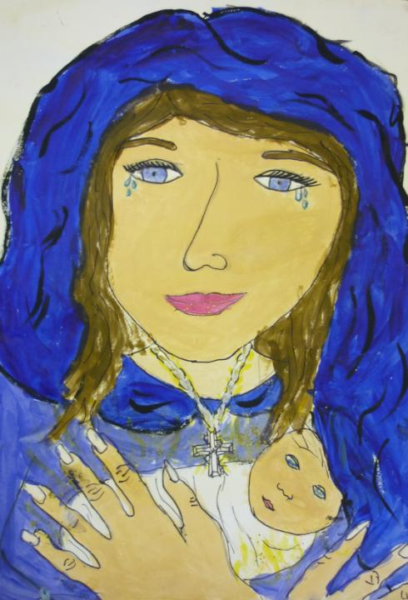
Emily, 10, from Derbyshire
The meaning of Christmas:
Prince of Peace
“My picture shows Mary holding Jesus, this is the key moment of the Christian festival of Christmas. If you look closely in Jesus’ eyes they are the earth. This represents that the world is in Jesus’ hands and there are rays of sunshine coming out of Jesus; that is the Holy Spirit. I believe he shines over all. I called my artwork ‘Prince of Peace’ because Jesus brings peace to the earth.
The cross around Mary’s neck is foretelling Jesus’ death. Mary’s tears are tears of joy but they are also tears of sadness because he is going to die for us.”

Slide 5
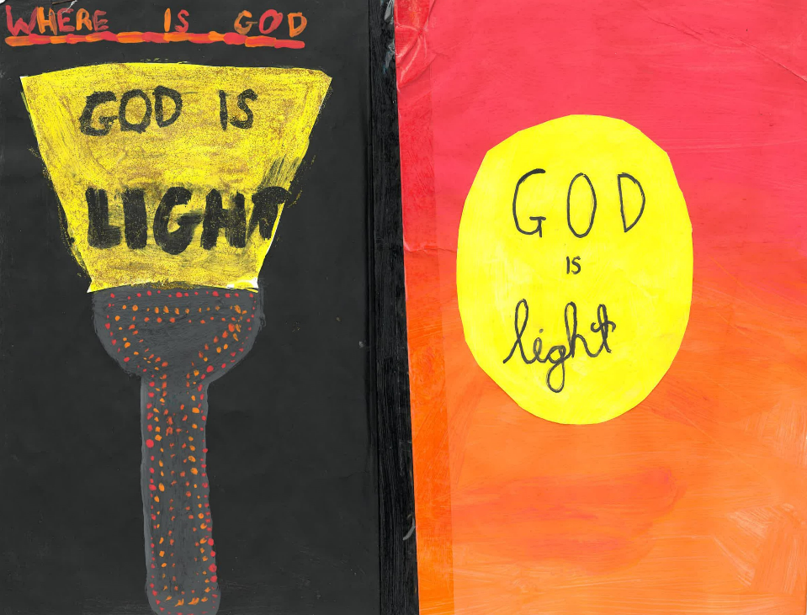

Itunu is 12. He is from Birmingham
The meaning of Christmas is that God Is the Light of the World
“The two pictures I have drawn represent the light of God. I have chosen these ideas because I always think to myself, where can God be? Then it occurred to me that God can be in the light, because if you think about it, light is everywhere. Light can be in the sun, artificial lights, your lamps, torches, a special insect which is called a firefly. In the Bible, it says that God came to be the light of the world when Jesus was born.
It is all about faith. You can’t see God. If you are in your room and it is dark, you should just think to yourself that God is with me and is protecting me. Another way to know that God is with you is just maybe turn on the lights.”

Slide 6
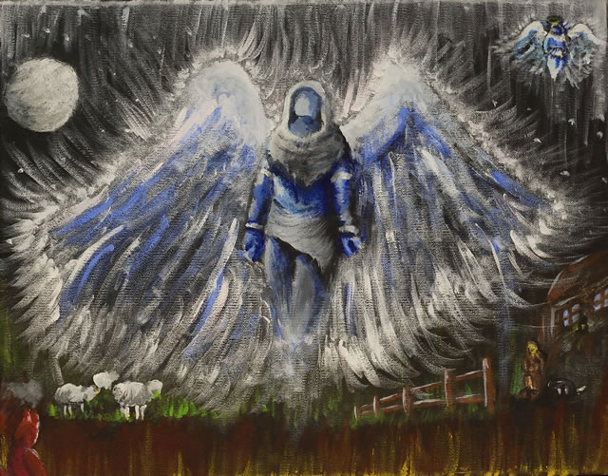

Slide 7

Angels, by Hayden, 16
“My painting is based on the visit to the shepherds from the angel Gabriel. The Spirit of God is represented by the colour blue, the colour of water, which washes the soul. This is the real turning point in any believer's life: redemption. With our free-will we turn to good or evil.
The Spirit, in fact, has no face. The angel Gabriel’s visit to the shepherds is at night time. It is the turning point in the life of the Shepherds. Those who saw the Christ child were forever changed: ‘they returned glorifying and praising God.’
My image also shows how God can create a turning point in our ordinary lives. Ordinary like the shepherds; yet significant enough for us to be visited by God’s Spirit.”

Slide 8
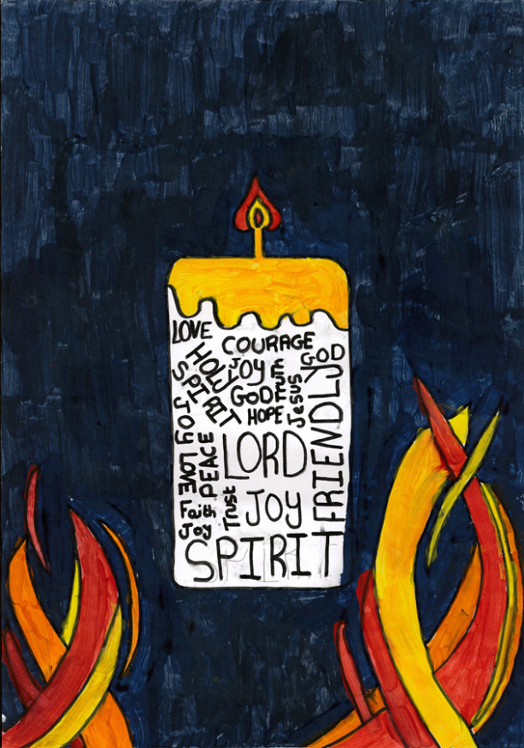
God who are you?
Poppy is 10.
Lord the light
“In my art you can see a candle with all of Gods qualities written in it. You can see flames coming up the sides and that represents the Holy Spirit. It shows that the Lord is the light of the world. In my picture you can see my candle is lit. this means he is lit so he is making the path of Christianity easier to see. My background is lighter than black because it is starting to light up the world. I think this is the real meaning of Christmas.”

Slide 9
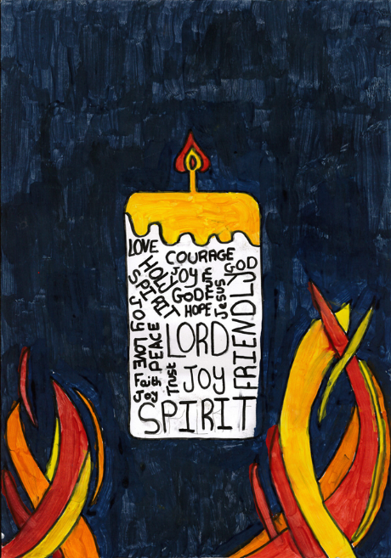



Which of these 4 works of art do you think has the best idea about the real meaning of Christmas? Why?

Slide 10
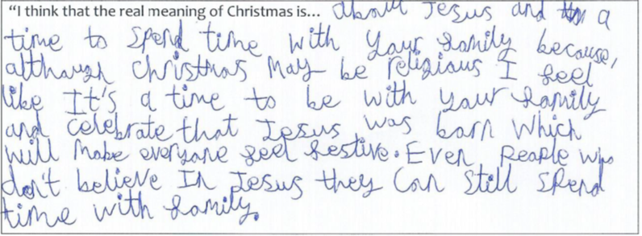
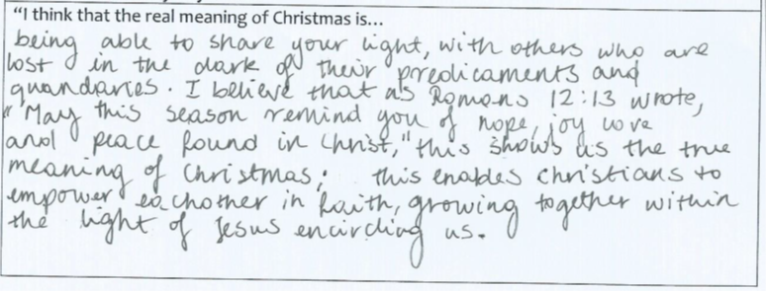

Slide 11
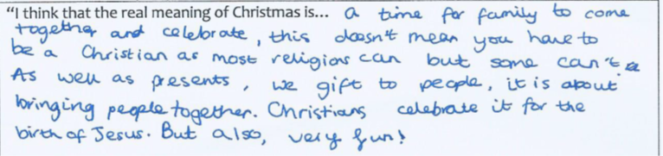
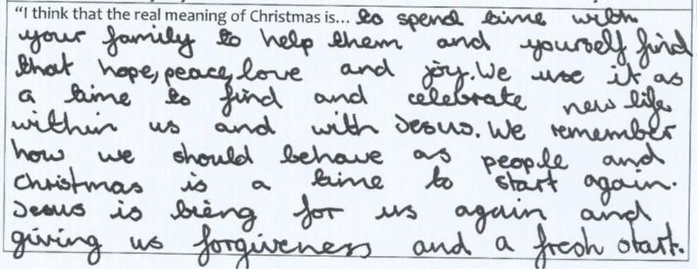

Slide 12
The real meaning of Christmas?
Lat Blaylock / RE Today

